Slide 1

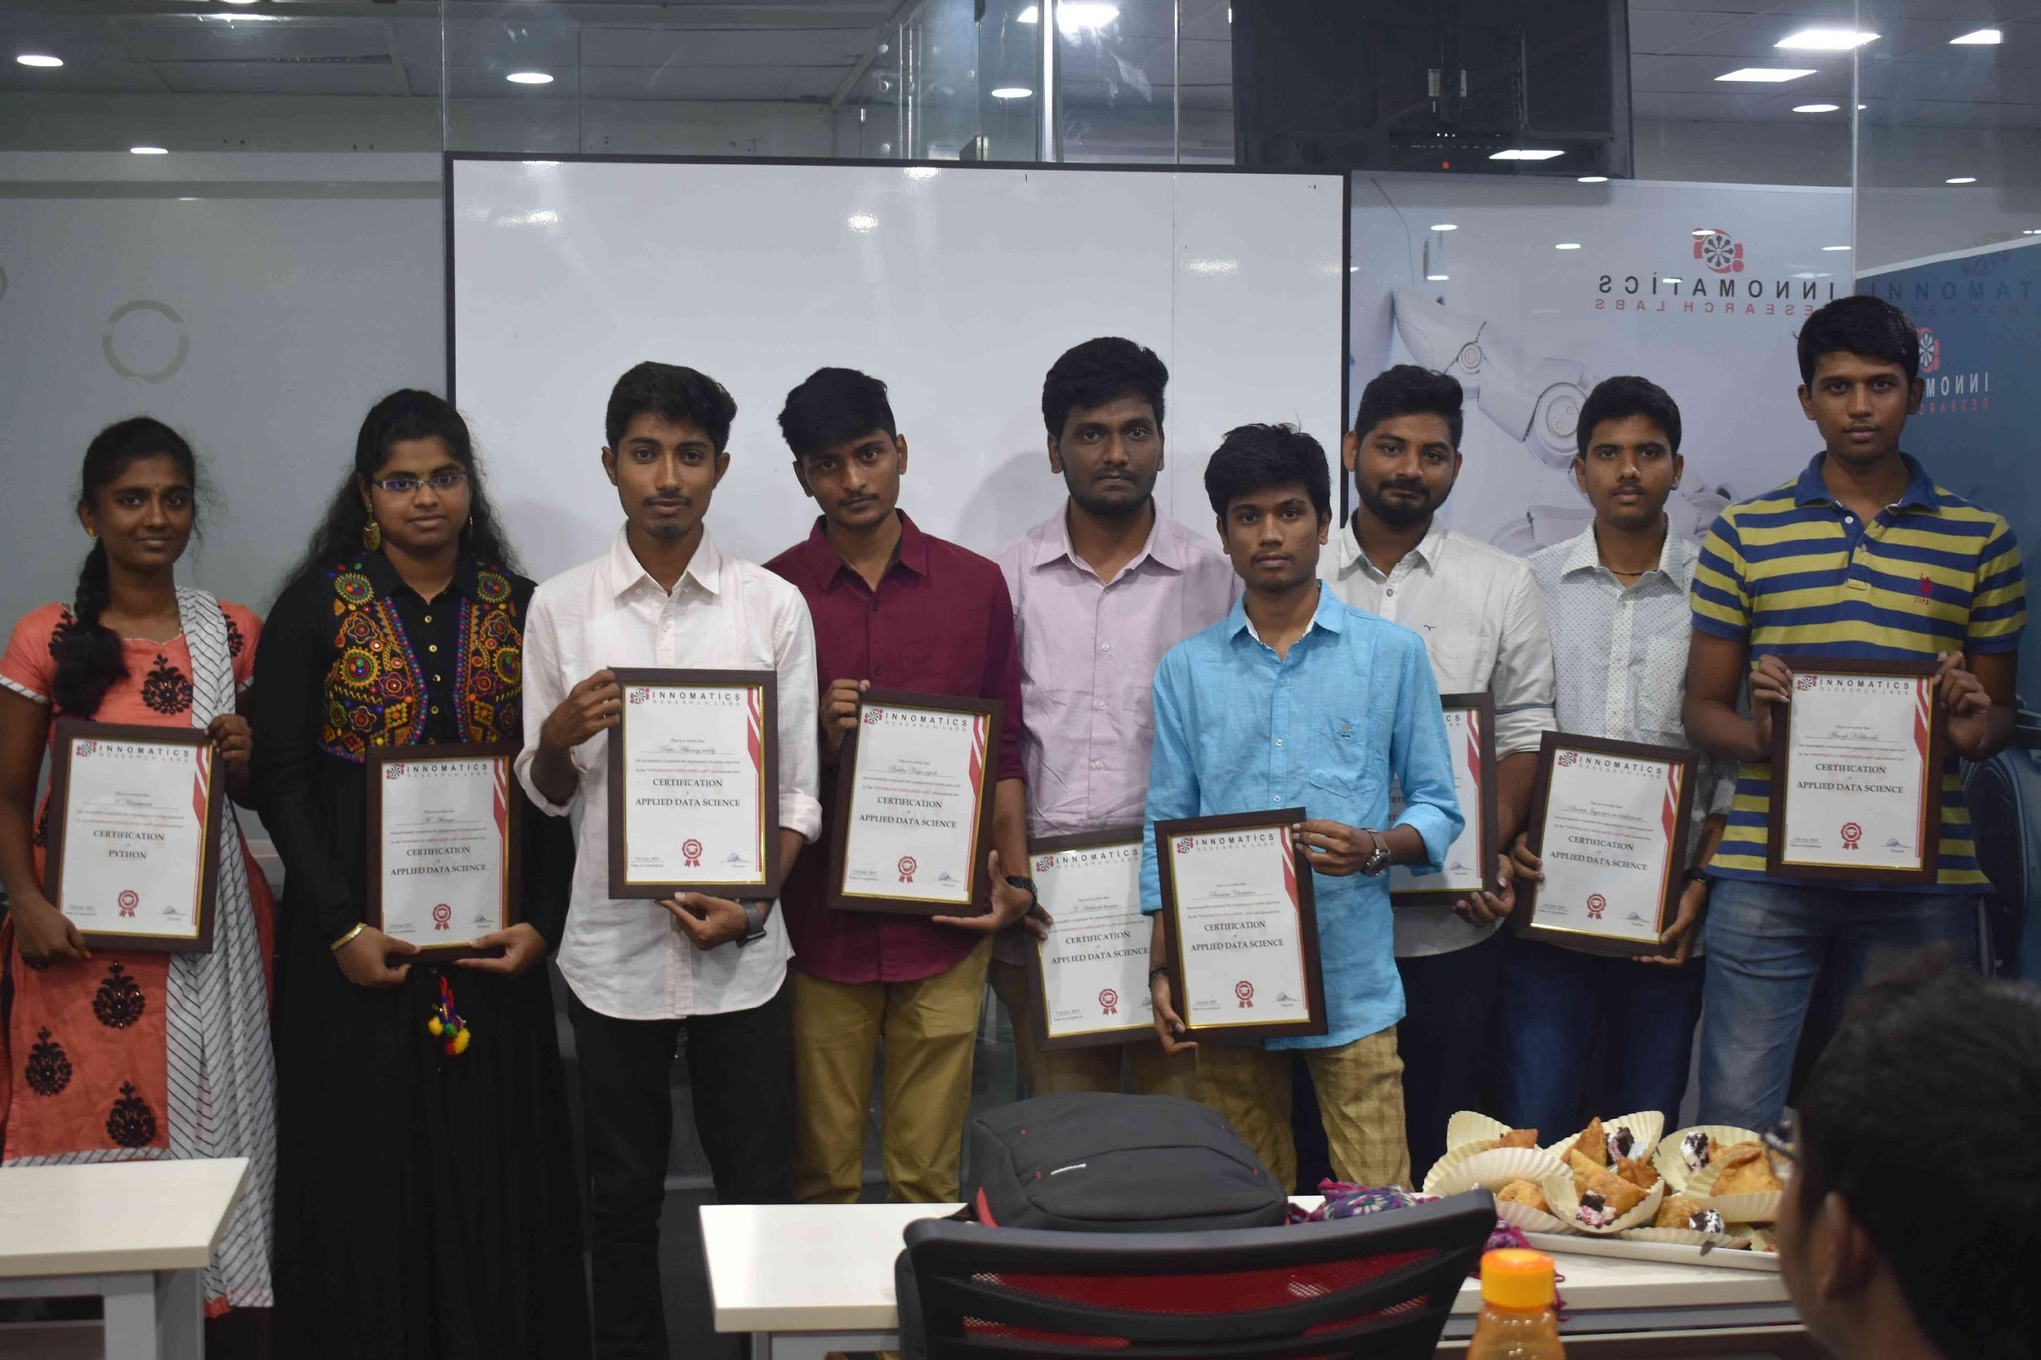
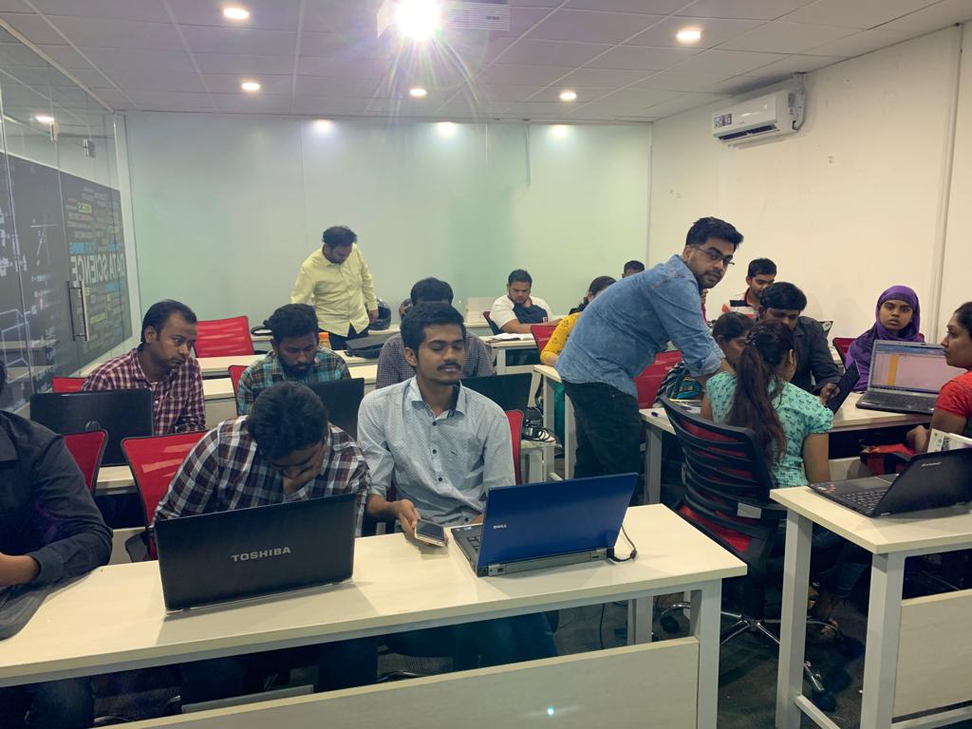

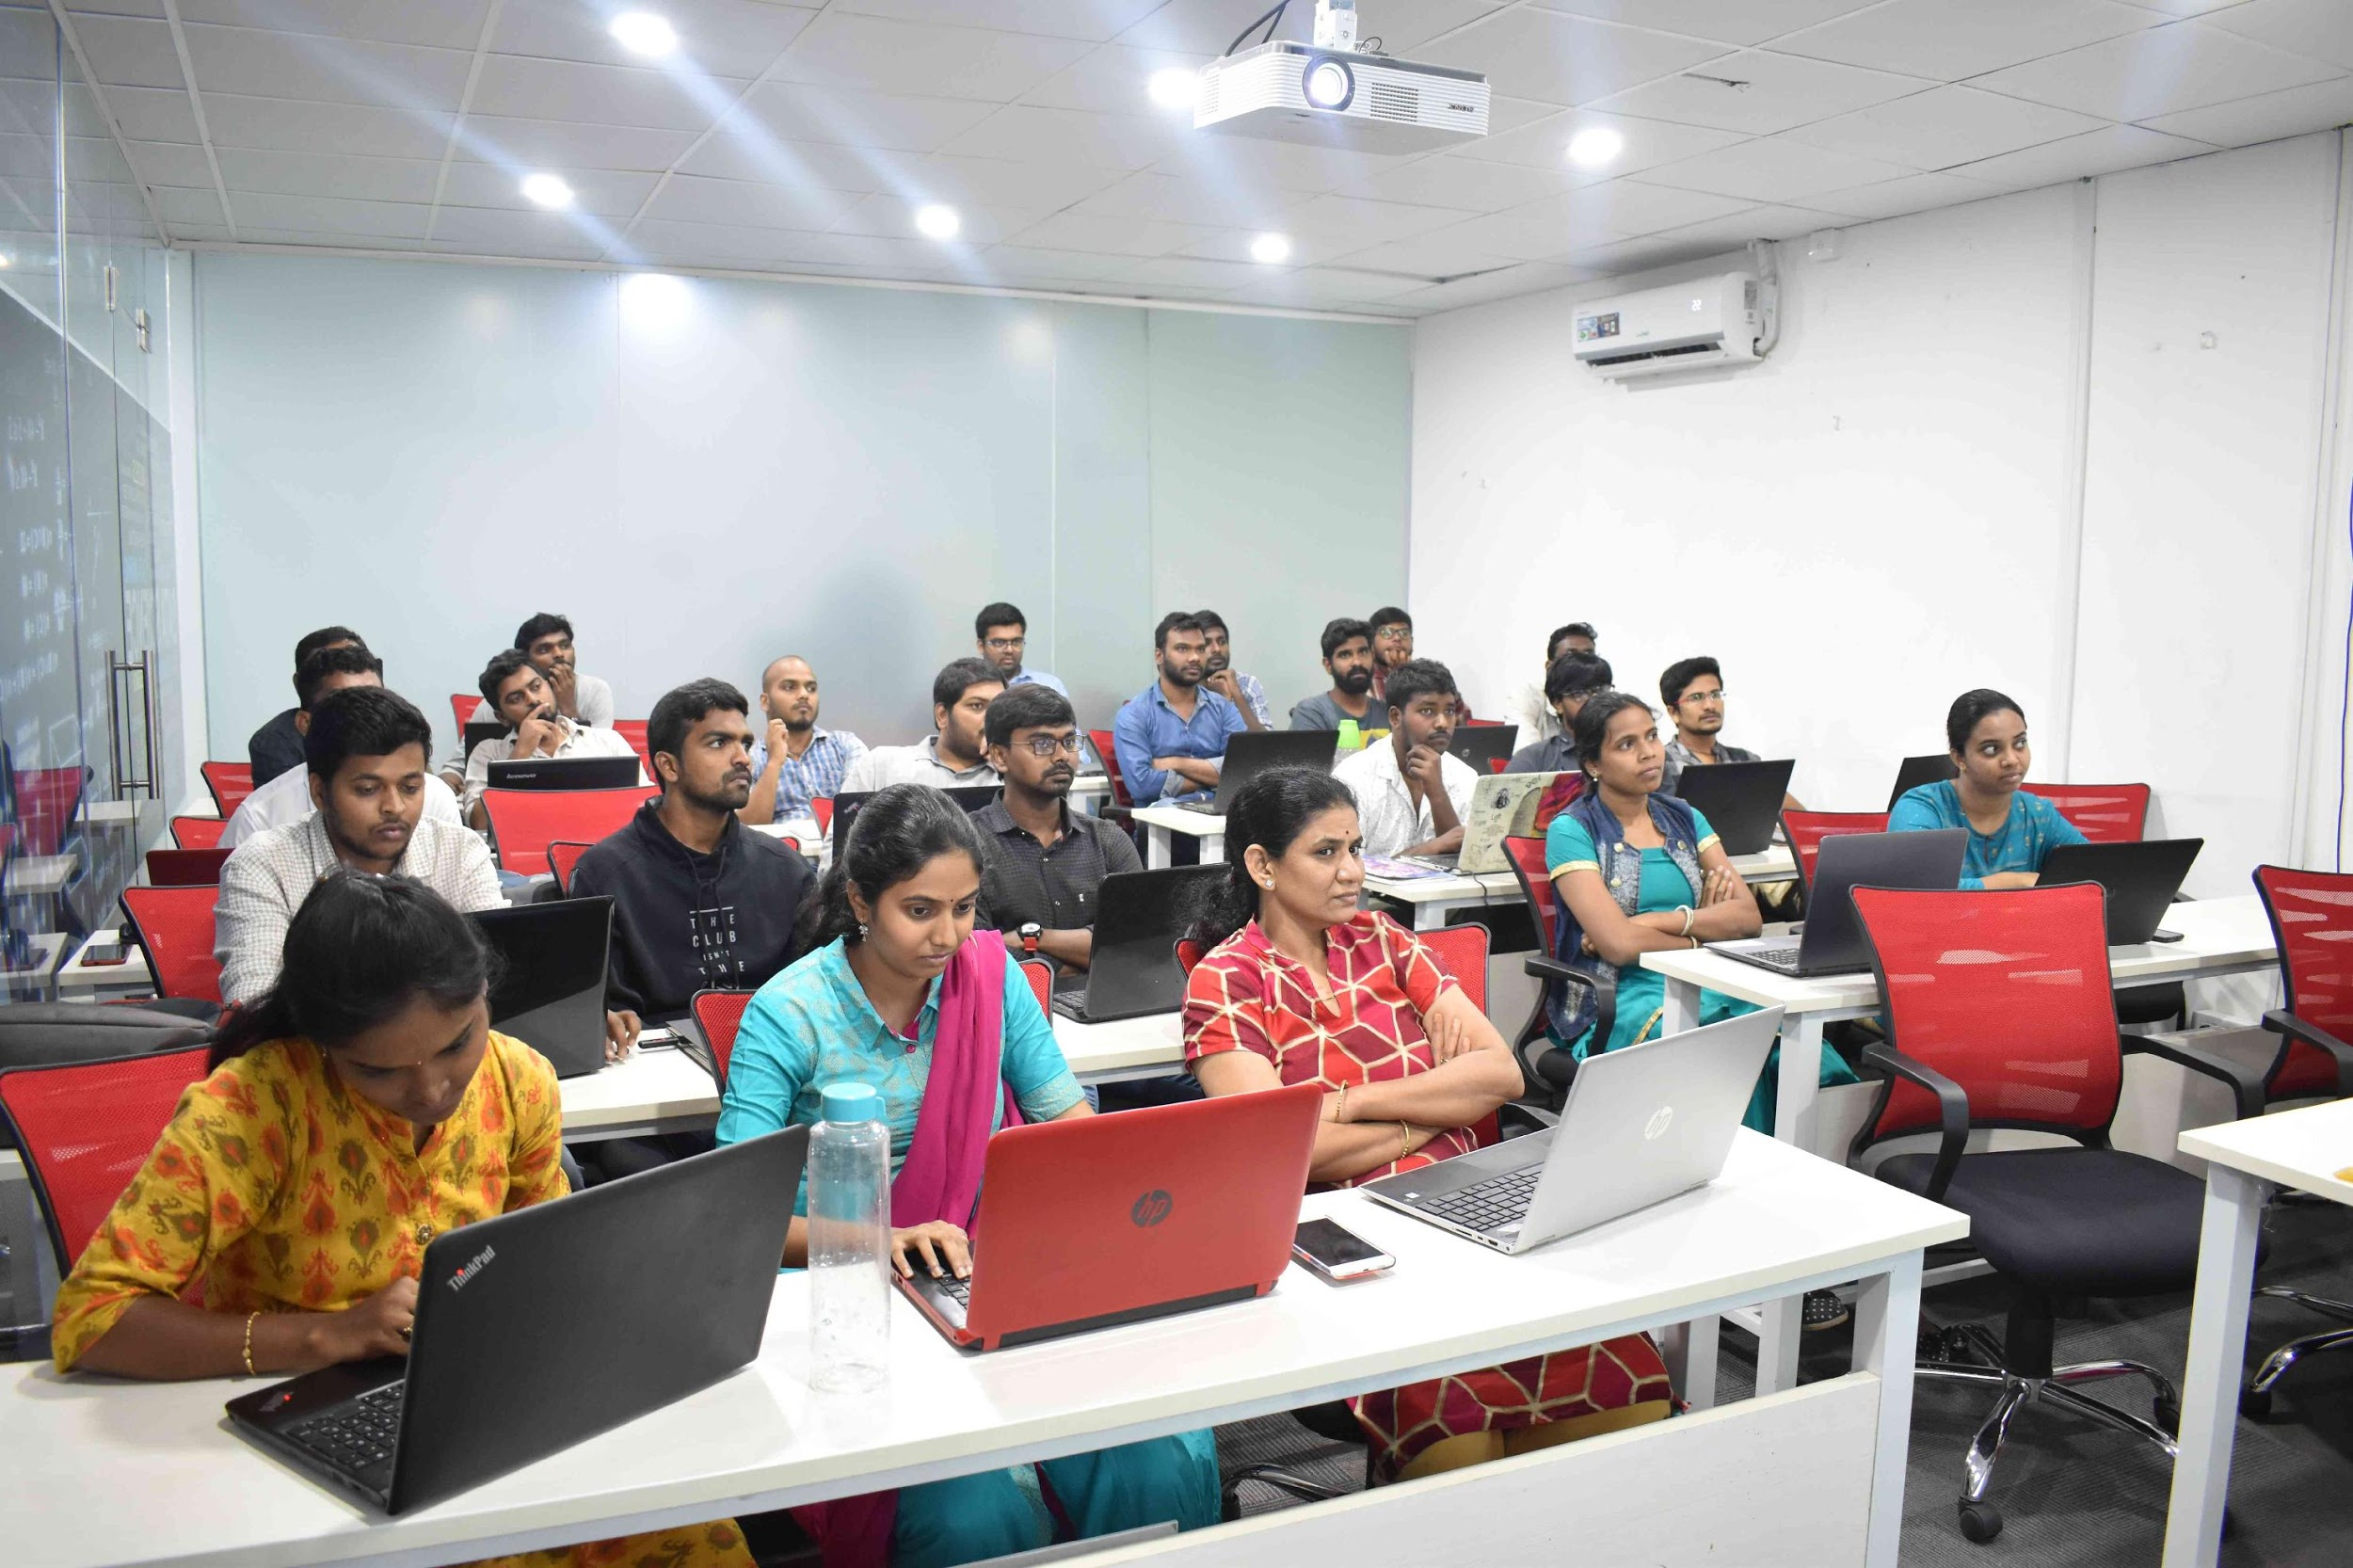



Slide 2
PROJECT ON
Exploratory Data Analysis on AMEO Dataset
BY
G V S SREERAM SARMA
IN1241203

Slide 3
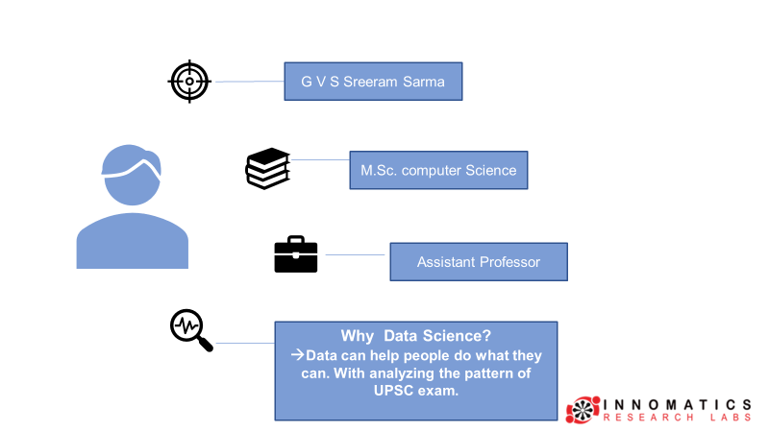
About me
Background ? (B-tech or M-tech)
Why you want to learn Data Science
Any work experience
What like you about Innomatics Research lab

Slide 4
OBJECTIVE OF THE PROJECT
The Aim is to gain the insight and understand the dataset particularly focusing on the relationship between various features and target variable (Salary).
Our goals of this analysis to DESCRIBE the dataset and Explore the relationship between independent and target Variable (Salary).

Slide 5
DATA CLEANING AND PREPROCESSING
To ensure the accuracy and consistency of our analysis, we convert the data types of ‘Date of joining (DOJ)’ and ‘Date of Leaving (DOL)’ fields to datetime format. The survey was conducted in 2015 by assumption we can change status ‘Present’ with ’31st December 2015’.
First, the columns ‘10board’, ’12board’, ‘GraduateYear’, ‘JobCity’, and ‘Domain’ were processed to replace null values represented by 0 or -1.
Following this columns with over 80% -1 values are present in ‘MechanicalEngg’, ‘ElectricalEngg’, ‘TelecomEngg’ , and ‘CivilEngg’ were removed.
The remaining optional subjects columns -1 values are replaced with 0 value which means that there are not pursued.
An additional column representing age has been include into the dataset by substracting the year of birth with present year.
Another feature , ‘Experience’ is introduced by substracting the ‘Date of leaving’ from the ‘Date of joining’. This indicate the experience of employees with in a company.

Slide 6
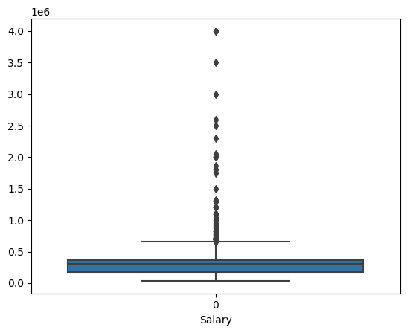
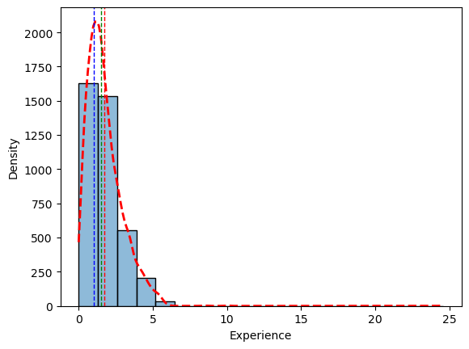
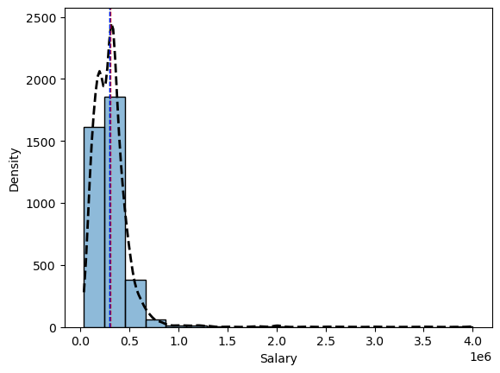
Univariate Analysis:
Experience ranged till 4-years and Histogram is positively skewed distribution
In salary we can observe that Histogram is positively skewed distribution with high concentration of observations having high salary.

Slide 7
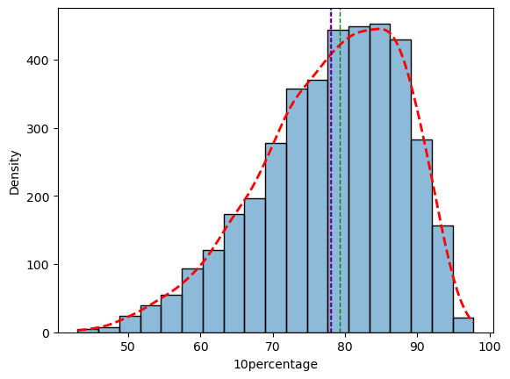
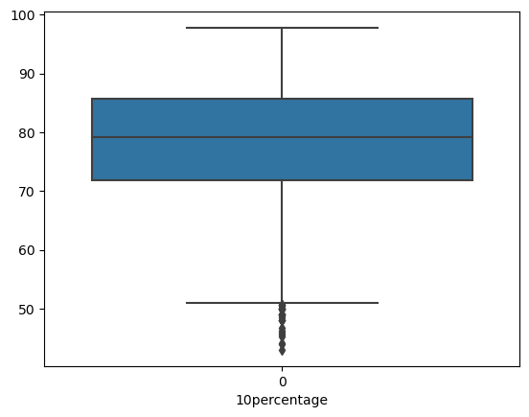
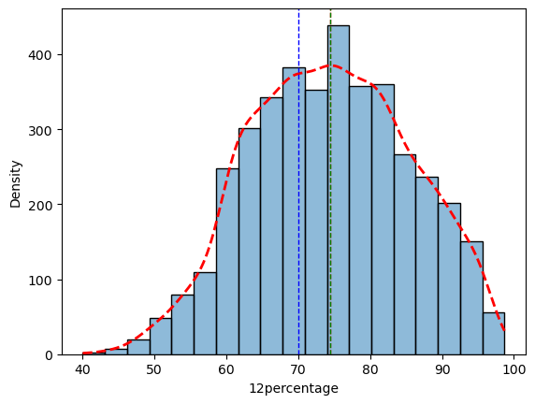
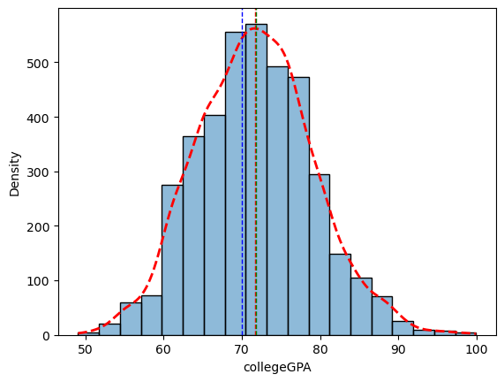
In 10th around Half of the students achieved 75% or more.
In 12th around Half of the students achieved 75% or less.
In collegeGPA most of students had GPA between 65% and 80%.

Slide 8
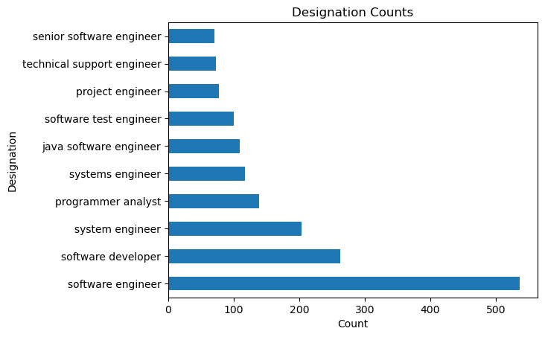
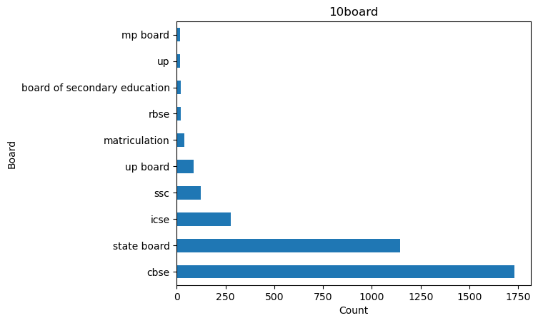
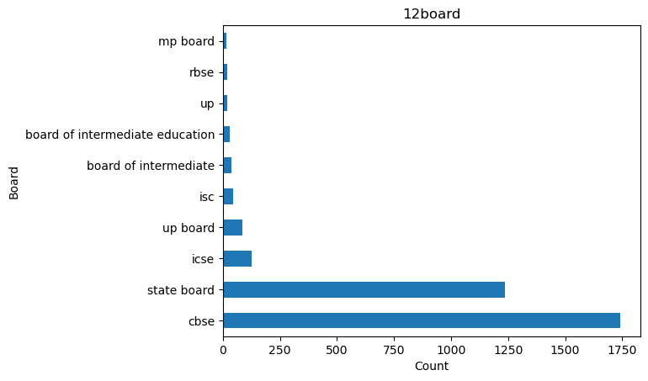
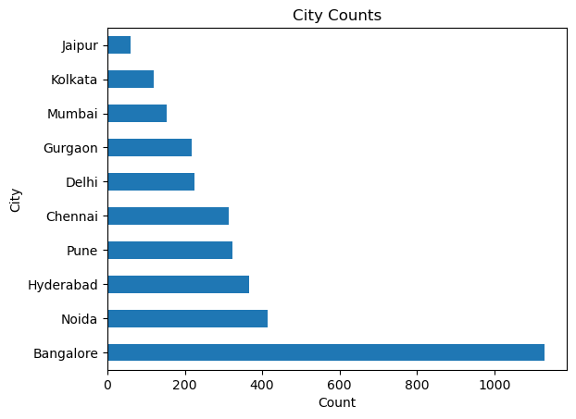
In terms of Designation Software Engineer as most prevalent followed by software developer, system engineer.
Regarding Job City preference Bangalore stands out for job placements followed by Noida.
CBSE emerges as the most school board.

Slide 9
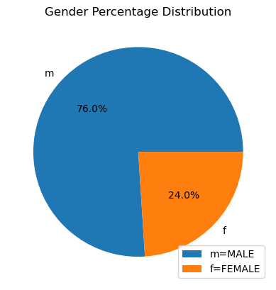
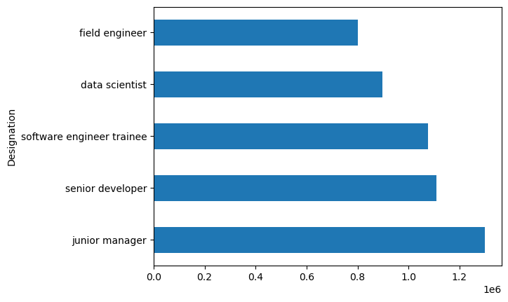
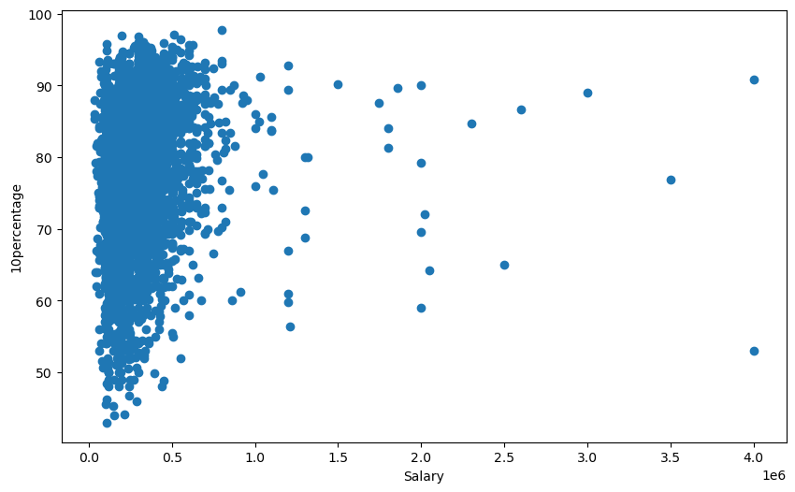
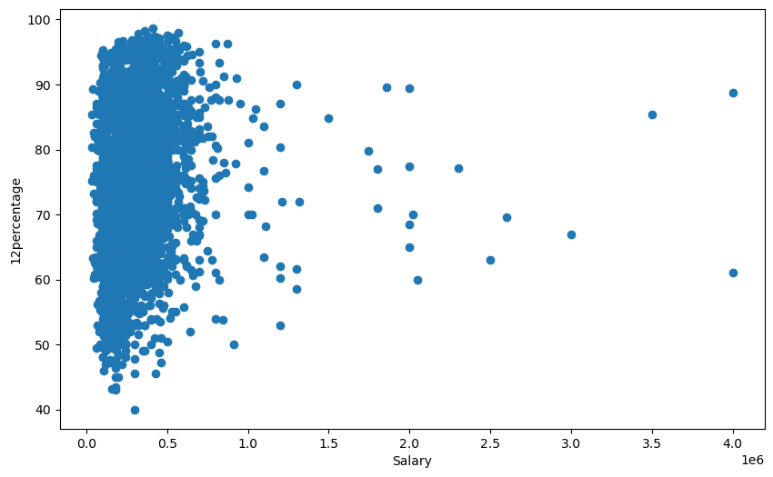
Gender Distribution have an imbalance with larger male population compared to Female.
Junior Manager have the highest salary followed with senior develop.
There is no significant correlation between 10th an 12th percentage on salary.

Slide 10
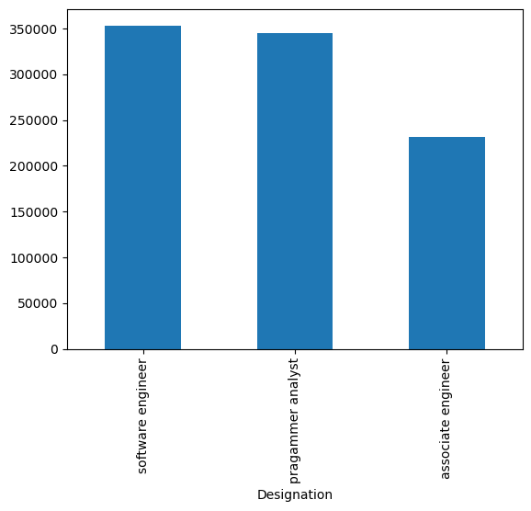
RESEARCH QUESTION
AVERAGE Salary for Each Designation after pursuing Computer Science Engineering

Slide 11
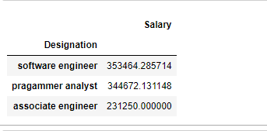
RESEARCH ANALYSIS OUTCOME:
“Times of India article dated Jan 18, 2019 states that “After doing your Computer Science Engineering if you take up jobs as a Programming Analyst, Software Engineer, Hardware Engineer and Associate Engineer you can earn up to 2.5-3 lakhs as a fresh graduate.” Test this claim with the data given to you.”
From the above Table we can say - The Salary for a Computer Science Engineer who takes job in Programming Analyst, Software Engineer or Associate Engineer can earn 2.5 to 3 lakhs

Slide 12

CONCLUSION:
We can say Age and Experience are directly impacts our Salary.
College performance won’t have much effect on our Salary.
The Salary for a Computer Science Engineer who takes job in Programming Analyst, Software Engineer or Associate Engineer can earn 2.5 to 3 lakhs.

Slide 13

THANK YOU

